Slide 1
ME469: Multiphase Methods: Volume of Fluid Methods
Stefan P. Domino^{1,2}
¹ Computational Thermal and Fluid Mechanics, Sandia National Laboratories
² Institute for Computational and Mathematical Engineering, Stanford
SAND2018-4536 PE

Slide 2
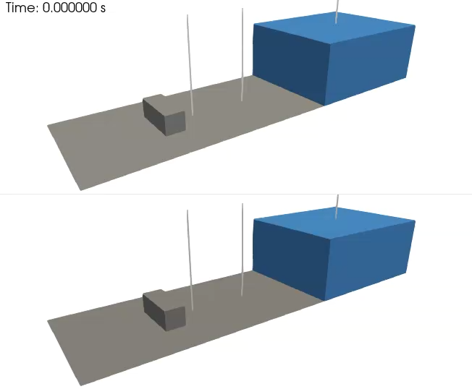
Objective: Model Multiphase Flow (Air/Water)
Validation case of Kleefsman et al. ”A volume-of-fluid based simulation method for wave impact problems”, J. Comput. Phys. (2005).
See:
/laboratory/3d_hex8_dam_break

Slide 3
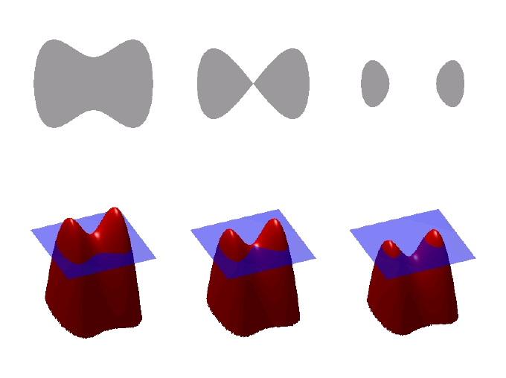
Step 1: Definition of an Water/Air interface (Phase 1/Phase 2)
Signed-distance function (level-set), Ψ
Popularized by Osher and Sethian, “Fronts propagating with curvature-dependent speed: Algorithms based on Hamilton-Jacobi formulations”, J. Comp. Phys., 1988,
Volume of Fluid, φ or α
Lineage classically provided to Noh, W.F.; Woodward, P. (1976). van de Vooren, A.I.; Zandbergen, P.J. (eds.). SLIC (Simple Line Interface Calculation). proceedings of 5th International Conference of Fluid Dynamics. Lecture Notes in Physics. Vol. 59. pp. 330–340
Interpretation: volume fraction of phase 1, interphase lives at ½
defines an zero-isocontour, with distance
(+/- in either direction)
Interface normal and curvature

Slide 4
Definition of an Water/Air interface (Phase 1/Phase 2)
Signed-distance function (level-set), Ψ
Popularized by Osher and Sethian, “Fronts propagating with curvature-dependent speed: Algorithms based on Hamilton-Jacobi formulations”, J. Comp. Phys., 1988,
Volume of Fluid, φ or α
Lineage classically provided to Noh, W.F.; Woodward, P. (1976). van de Vooren, A.I.; Zandbergen, P.J. (eds.). SLIC (Simple Line Interface Calculation). proceedings of 5th International Conference of Fluid Dynamics. Lecture Notes in Physics. Vol. 59. pp. 330–340
Interpretation: volume fraction of phase 1, interphase lives at ½
defines an zero-isocontour, with distance
(+/- in either direction)
Interface normal and curvature

Slide 5
VOF Transport Discretization Nuance: Volume- or Surface-based?
Simple enough, define the volume (fraction) of fluid (absent evaporation):
Option 1: volumetric-form:
Option 2: divergence-form:
CVFEM/FEM (really, any element-based approach)
Evaluated as a volumetric-contribution (diamonds)
Gauss-Divergence
Traditional finite volume (element, edge, cell-centered)
Evaluated as a surface integral (triangle)
Allows for a consistent advecting velocity (mass conserving)
that is obtained from the continuity equation

Slide 6
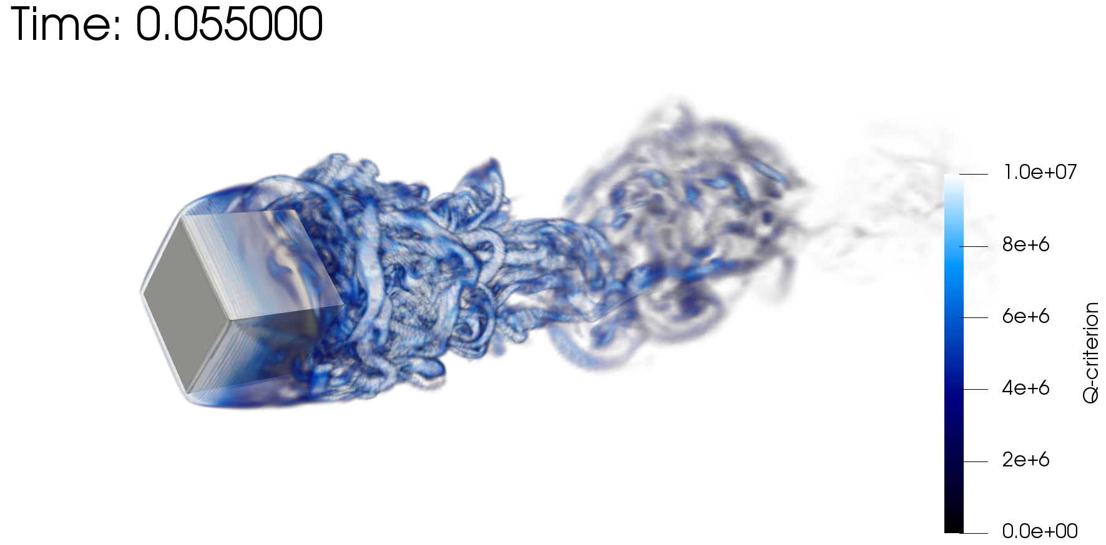
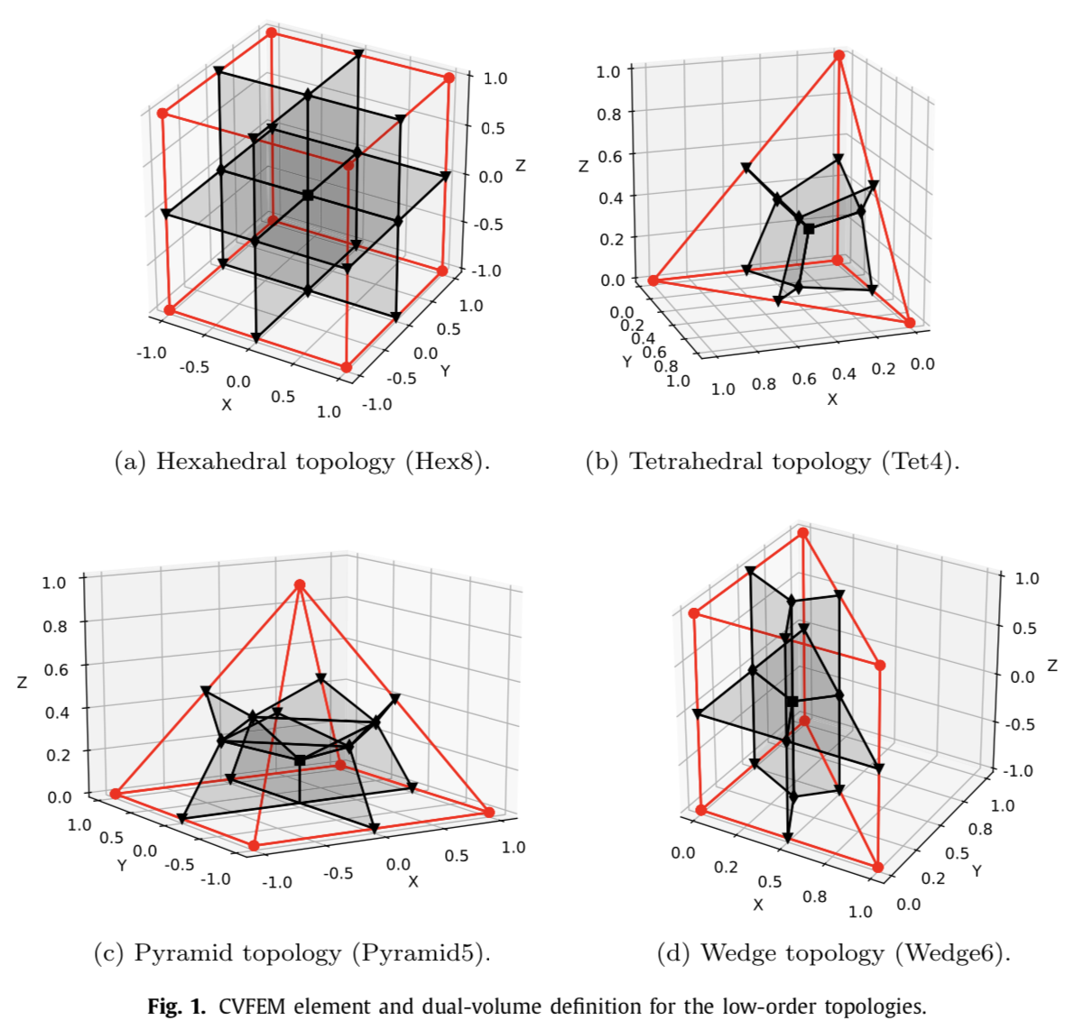
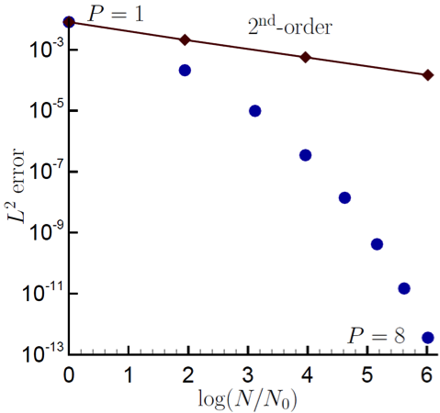
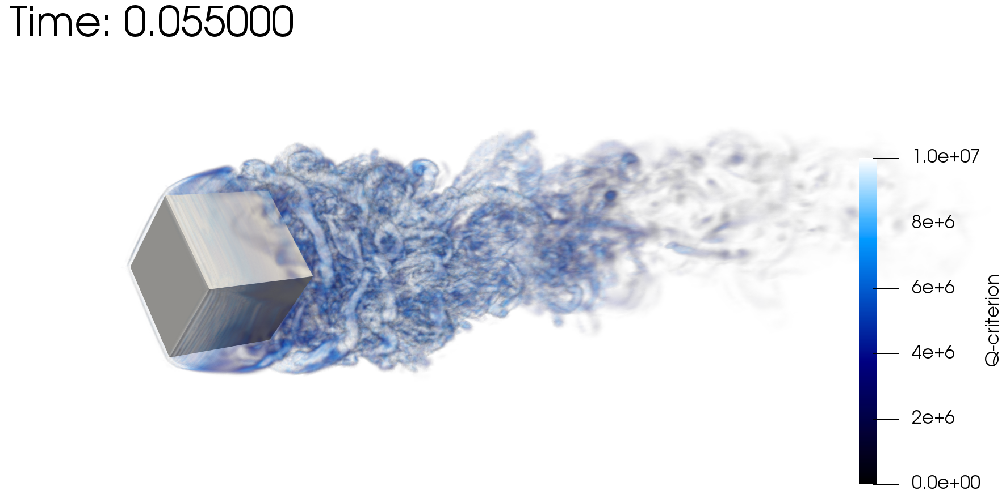
Baseline: Generalized, Unstructured Numerical Formulation
Objective: Scalable, Efficient fluids on hybrid-based mesh constructs
Rotating cube (Re 4000, RPM 3600)
P=1 (top) and P=2 (bottom)
CVFEM can be viewed as Petrov-Galerkin method (basis differs from test function)
High-quality on generalized unstructured meshes, Domino et al. Comput. Fluids (2019)
The method can also be promoted in polynomial space, see Domino, CTRSP (2014) as a first example of low-Mach fluids algorithm – or Domino, J. Comp. Phys. (2018)
GPU, Knaus, Comput. Fluids (2022)
Control-volume finite-element method (CVFEM)

Slide 7
Equal-Order Interpolation, i.e., Collocation: Pressure Stabilization Review (1/2)
A variety of forms/explanations – depending on the particular community; at it’s base:
What is ? (next slide)?
Projected nodal gradient that
can be mass-lumped

Slide 8
Equal-Order Interpolation, i.e., Collocation: Pressure Stabilization Review (2/2)
is a function of the fine-scale momentum residual (evaluated at an integration point):
We can also project this residual to the nodes, and approximate R^{h}(u_{j}) as re-interpolation of choice terms
Usage of a full residual (1) results in a classic Pressure Stabilized Petrov Galerkin (Hughes et al. 1986)
Pick and choose each residual, Majumdar (1988)
Algebraically manipulation affords the classic Rhie-Chow-based (1983) pressure stabilization
- shown to be stable and dissipative [Ham and Iaccarino (2004) or Domino (2006)]
There is also the nuance of pressure projection vs monolithic
(1)

Slide 9
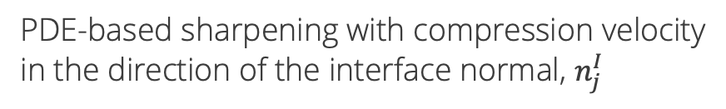
VOF Transport: Sharpening + Advection Stabilization + Interface Smoothing
VOF equation with PDE-based sharpening (to mitigate numerical diffusion) that includes residual-based stabilization
Integrated-by-parts advection to allow for consistent continuity constraint; R^{h}(α)
PDE-based sharpening with compression velocity
in the direction of the interface normal, $n_{j}^{I}$
Streamwise-upwind, control volume (SUCV), Swaminanthan et al., Int. J. Numer.
Meth. Engr. (1993); based on Streamwise Upwind Petrov-Galerkin (SUPG),
Brooks and Hughes, Comput. Methods in Appl. Mech. Eng. (1982).
Nonlinear stabilization operator (NSO); Motivated by Shakib et. al, Comput.
Methods in Appl. Mech. Eng. (1991), discontinuity capturing operator
(later termed NSO); ν^{h} = f(R^{h}(α)) NSO and SUCV avoids common gradient
reconstruction techniques commonly used in unstructured formulations, see
Tsui et al., Int. J. Heat Mass Trans. (2009)
Nuance: interface normal can be computed using a smoothed VOF field

Slide 10
VOF using Balanced Force: Brief Survey
First CVFEM: Lin et al, J. Comput. Phys. (2019)
Classic Balanced Force, Francois, J. Comput. Phys. (2006) ported to CVFEM
Parasitic currents suppressed via a consistent momentum/continuity stabilization form: fine-scale momentum residual algebraically modified in continuity equation
Note: not trying to pioneer a novel balanced force approach
Nodal pressure gradient
Momentum Equation
Convecting-velocity
Continuity Equation
Note: benefits from ρg_{i} (γ = 1) included in stabilization

Slide 11
VOF using Balanced Force: Leveraging Existing Approaches
First CVFEM: Lin et al, J. Comput. Phys. (2019)
Classic Balanced Force, Francois, J. Comput. Phys. (2006) ported to CVFEM
Parasitic currents suppressed via a consistent momentum/continuity stabilization form: fine-scale momentum residual algebraically modified in continuity equation
Note: not trying to pioneer a novel balanced force approach
Surface tension Continuum Surface Force (CSF)
Momentum Equation
Continuity Equation
Note: benefits from ρg_{i} (γ = 1) included in stabilization

Slide 12
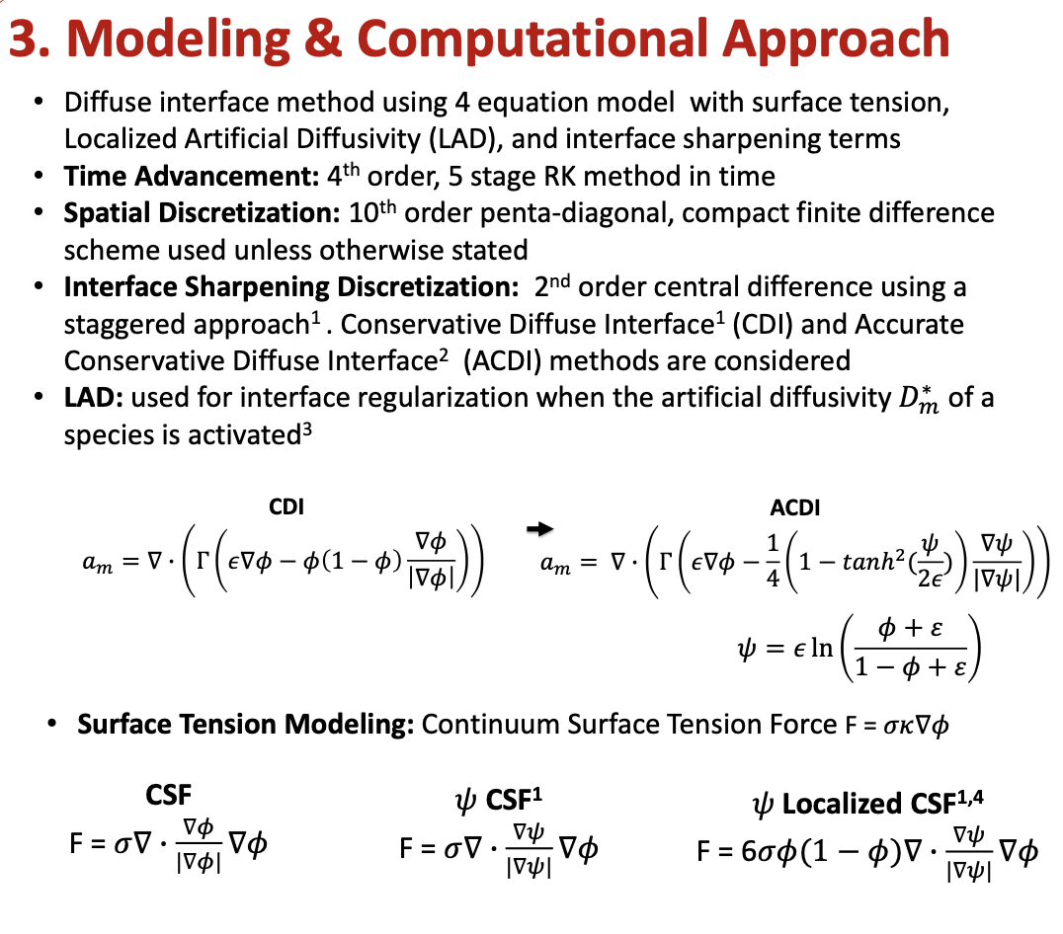
A Note on Methods and CSF
Many (local!!) experts:
Jain et al., A conservative diffuse-interface method for compressible two-phase flows, J. Comp. Phys, 2020.
Jain, “Accurate conservative phase-field method for simulation of two-phase flows, J. Comp. Phys, 2022.
Mirjalili et al., Assessment of an energy-based surface tension model for simulation of two-phase flows using second-order phase field methods, J. Comp. Phys. 2023.
Huang and Jain, “A phase-filed method for simulations of two-phase flows on unstructured grids”, Annual CTR Briefs, 2022.
Barbeau and Lele, Assessment of Localized Artificial Diffusivity (LAD) and Interface Sharpening for Modelling a Two-Phase Mixing Layer, PSAAP-3 Poster Session.

Slide 13
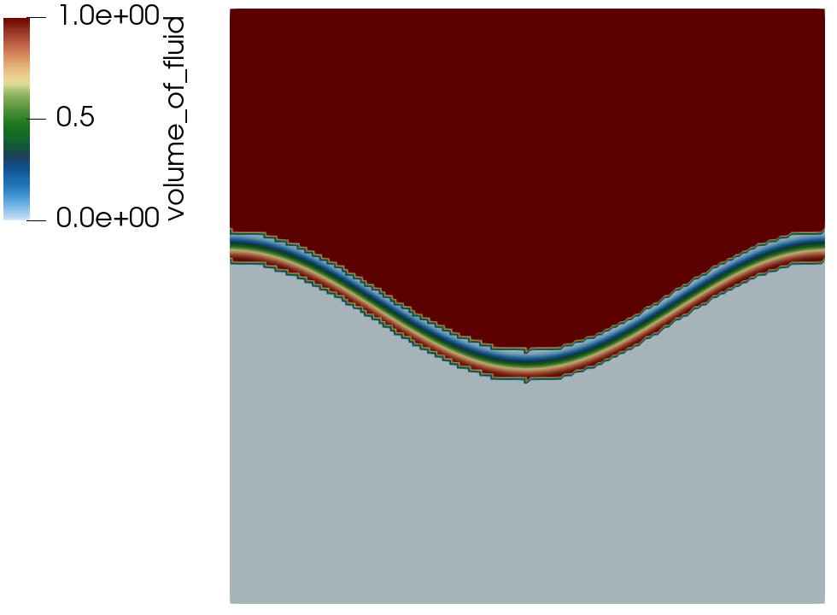
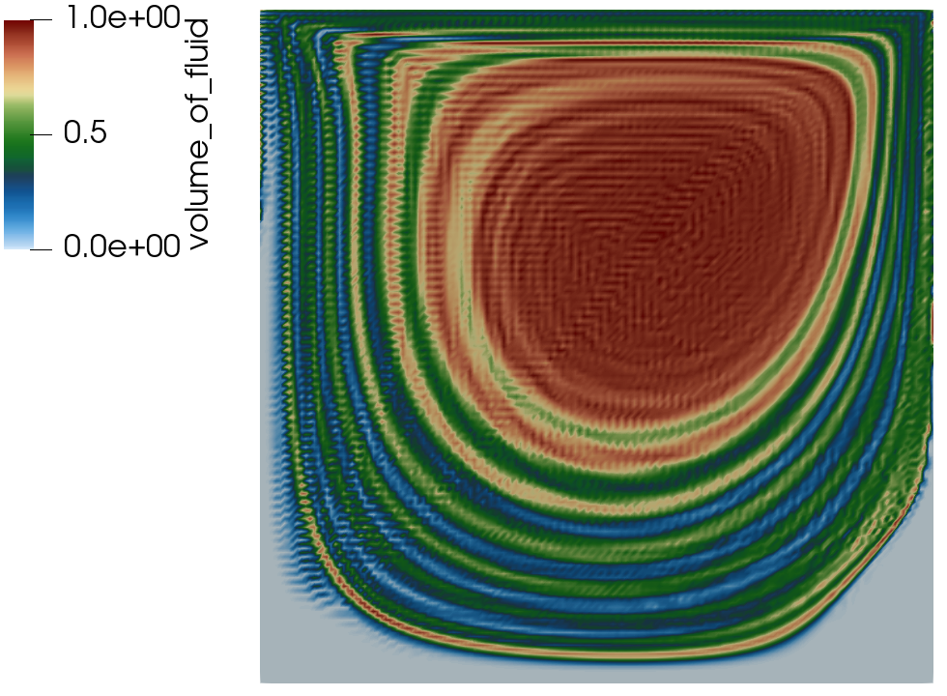
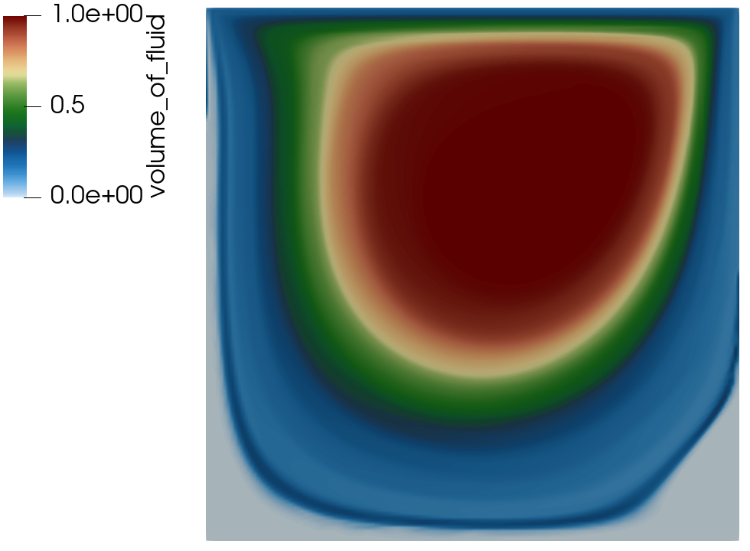
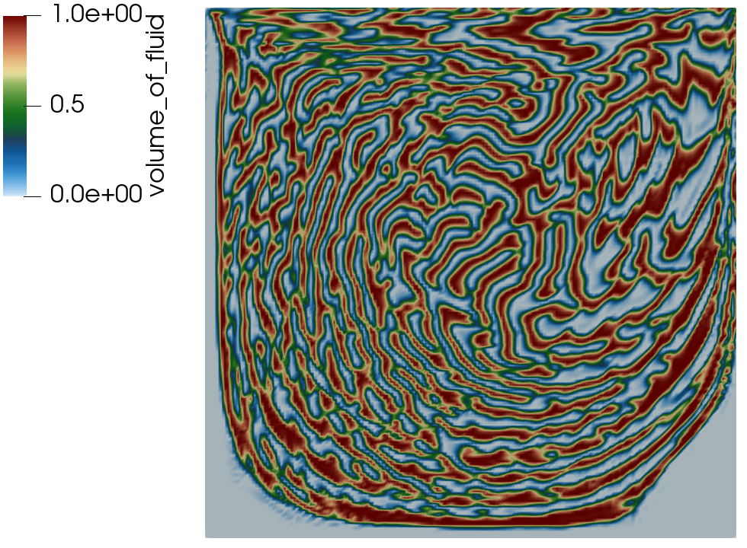
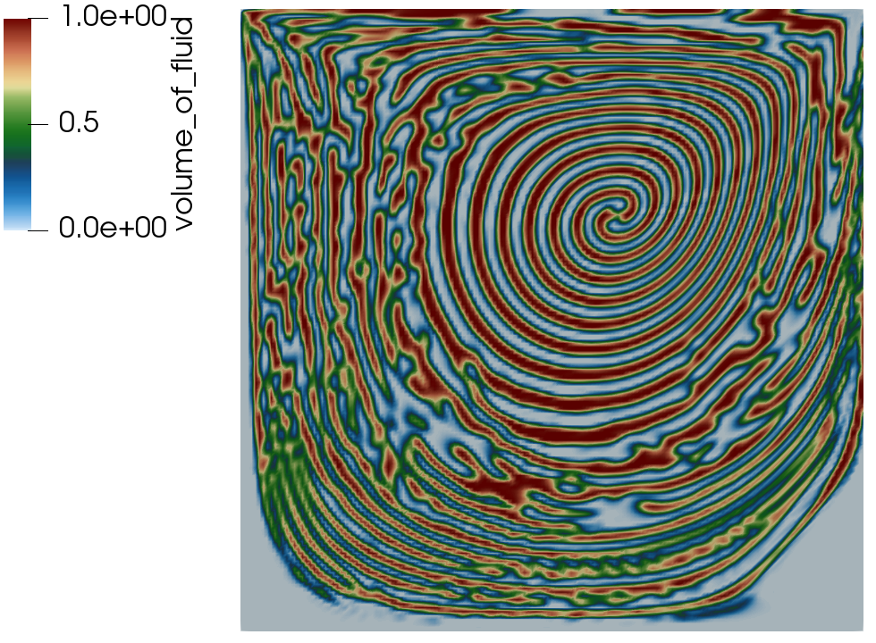
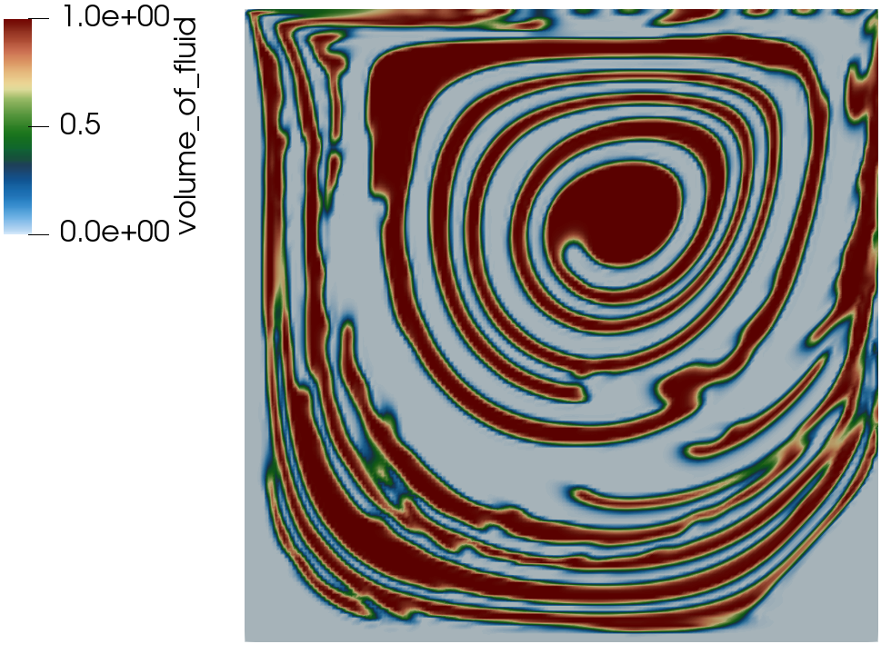
Passive Transport Example: Driven Cavity
Exploring PDE-based sharpening, interface smoothing and stabilization
Initial condition
No stabilization
SUCV+NSO
Sharpening+B
Sharpen+C
E+Smoothing
A B C
D E F

Slide 14
Residual-based stabilization
Molenkamp verification, see Martinez, Int. J. Numer. Meth. Engr. (2004), with a variety of stabilization options
Conformal mesh results
(stay tuned for overset)
First-order, upwind (FOUPW)
Second-order, UPW+Limit (SOUPW, limit)
SUCV, Polynomial-order = 1
SUCV, Polynomial-order = 2

Slide 15

Dam Break Validation: The Benefit of a Full Balanced-Force Method
Here, comparisons made between γ = 1 (top) and γ = 0 (bottom) showcasing the increased stabilizing effect of the set of all body forces in momentum included in the pressure stabilization formulation
A nuance briefly captured and/or hinted at in seminal Francois et al., J. Comput. Phys. (2006) effort
R0

Slide 16
Dam Break Validation: The Benefit of a Full Balanced-Force Method
Here, comparisons made between γ = 1 (top) and γ = 0 (bottom) showcasing the increased stabilizing effect of the set of all body forces in momentum included in the pressure stabilization formulation
A nuance briefly captured and/or hinted at in seminal Francois et al., J. Comput. Phys. (2006) effort
R2

Slide 17
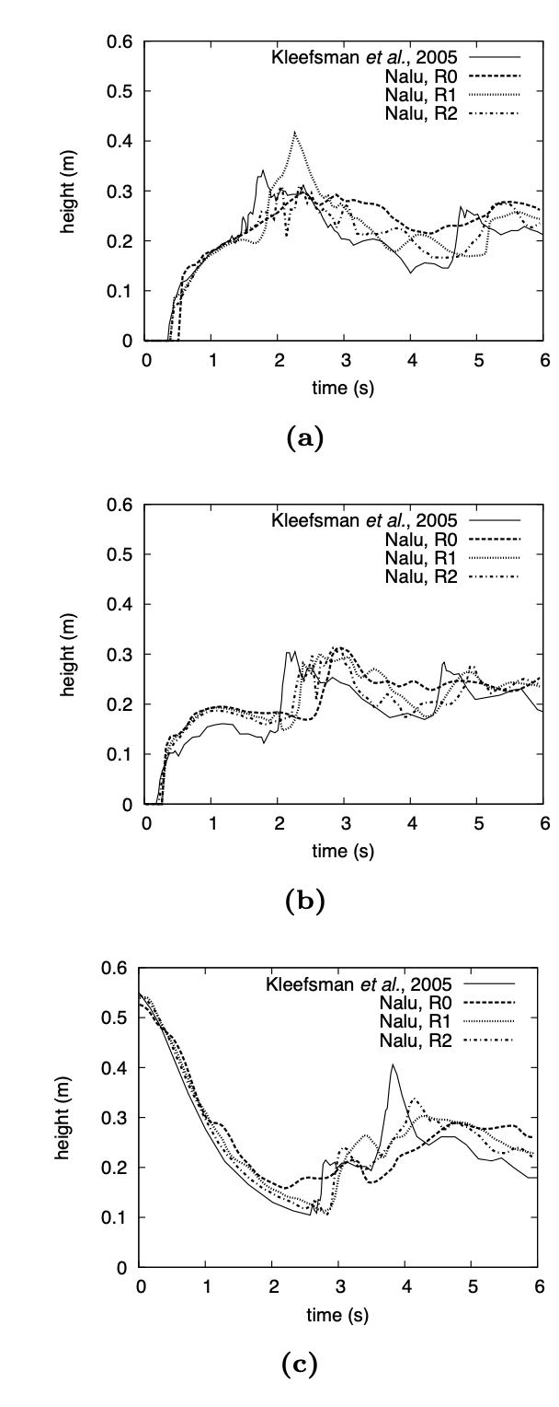
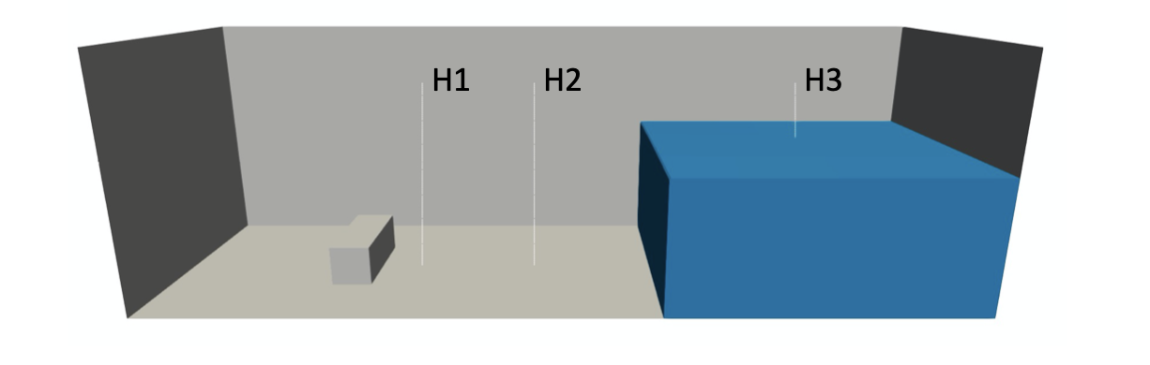
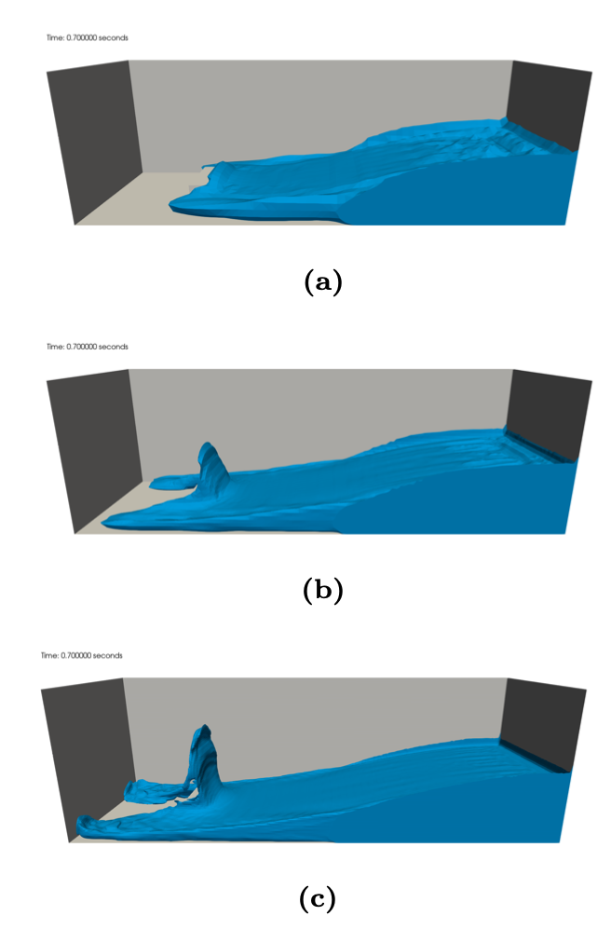
Dam Break Validation
H1
Validation case of Kleefsman et al. ”A volume-of-fluid based simulation method for wave impact problems”, J. Comput. Phys. (2005).
Qualitative comparisons also made to SNL’s Sierra/Fuego, Brown et al. “Modeling a rubble fire consisting of comingled liquid and solid fuel”, Tech. Rep. SAND2017- 12318C (2017).
R0
H2
R1
R2
H3

Slide 18
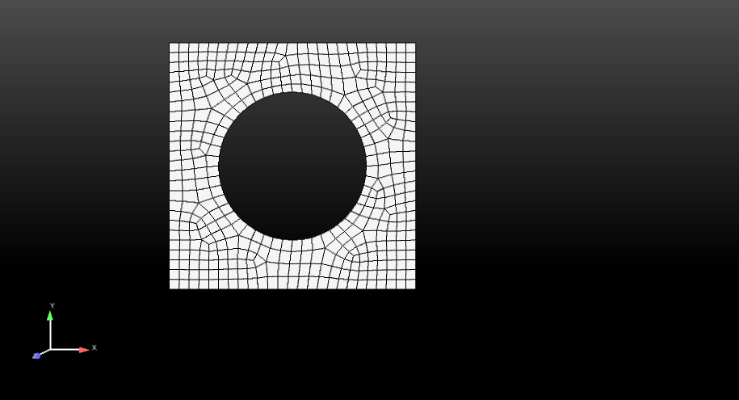
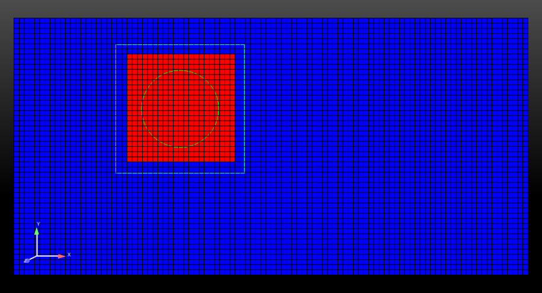
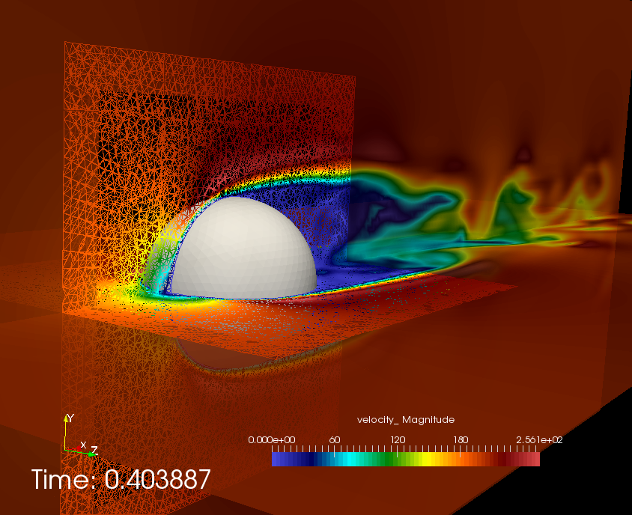
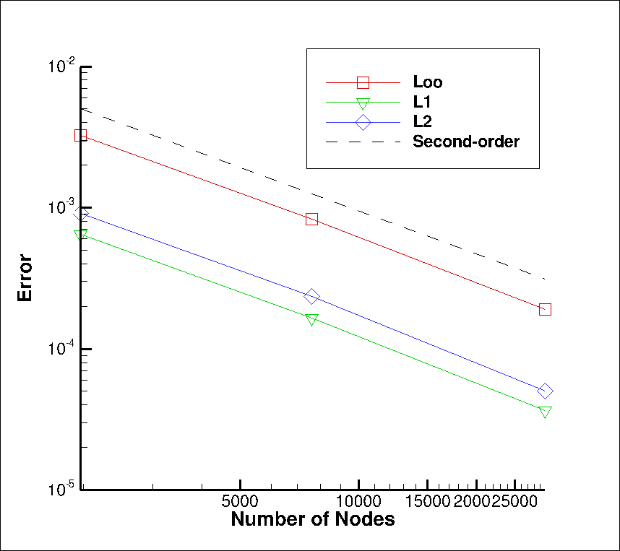
Overset: Freedom for Generalized Motion
Implicit, constraint-based overset-based approach (DG/CVFEM-based, started)
Does not require presumed movement
Similar to Nalu-Wind’s Sharma et al, J. Comput. Phys. (2021), however, STK-based search
BLOCK_2
BLOCK_3 (newly declared and
changed part)
Constraint-based
Fringe
BLOCK_1
Surface_1 (read in)
Surface_101 (newly declared and changed part)
Fluids Hex/Tet
MMS

Slide 19
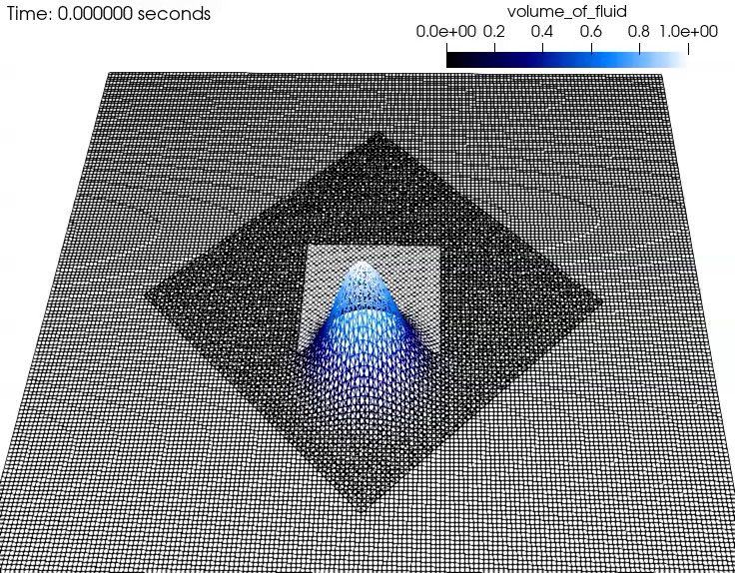
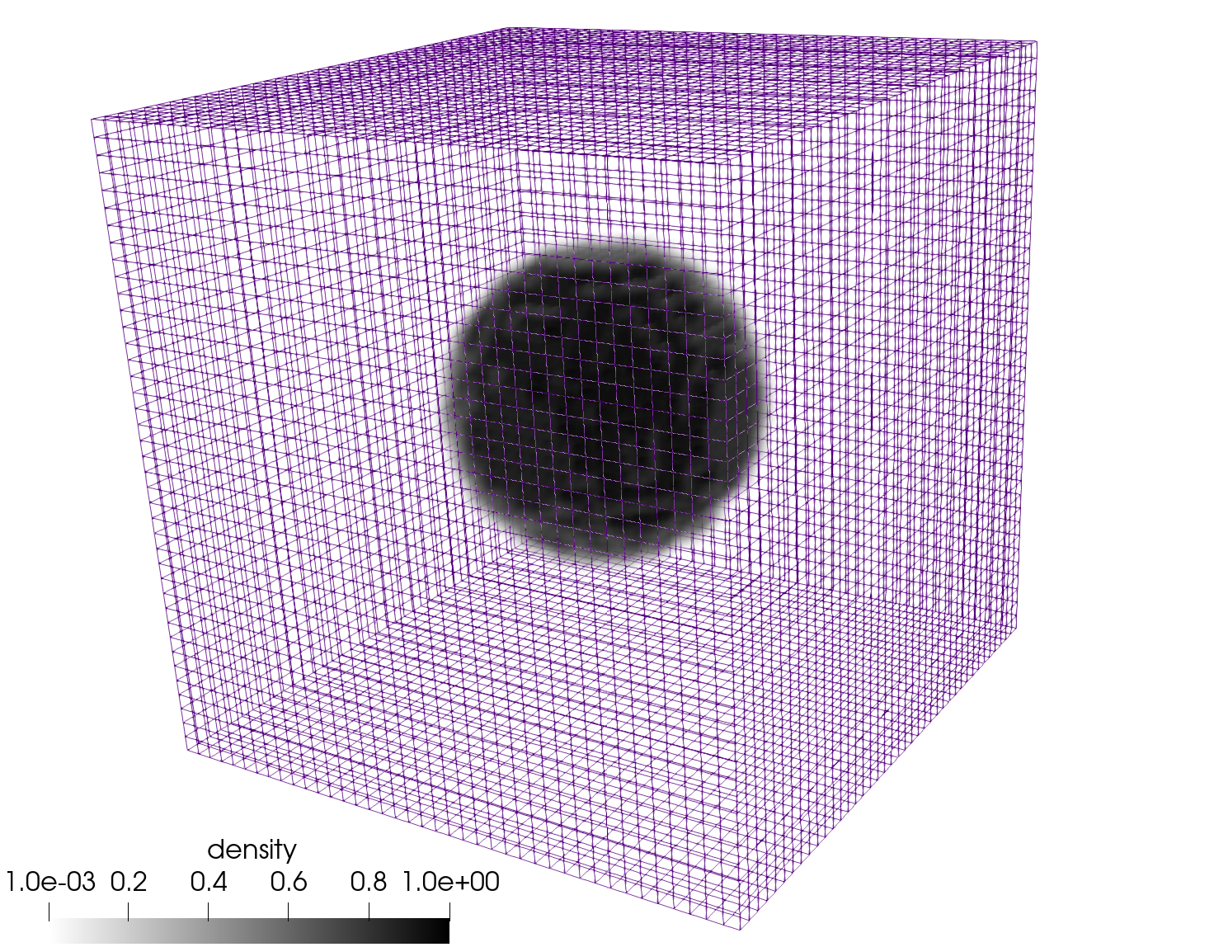
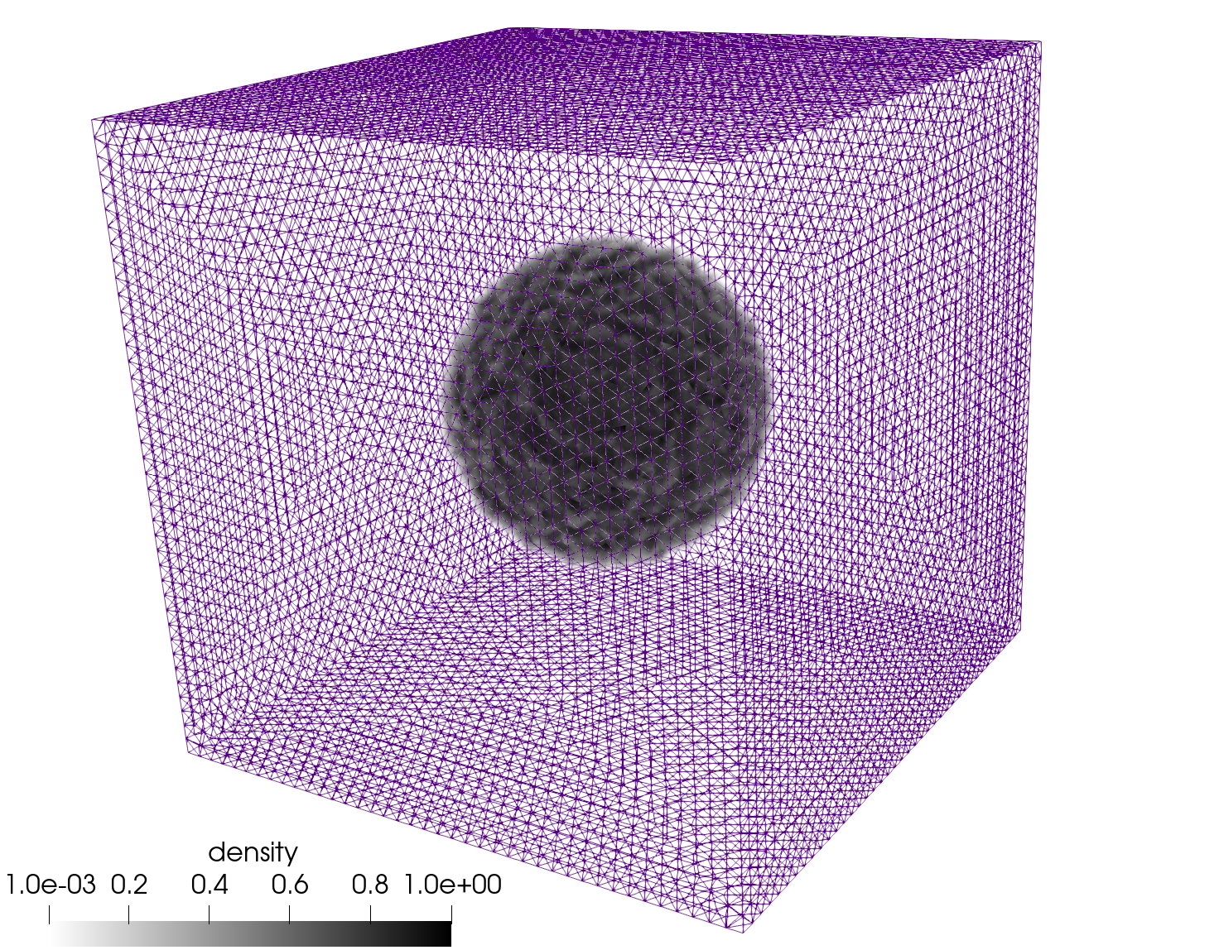
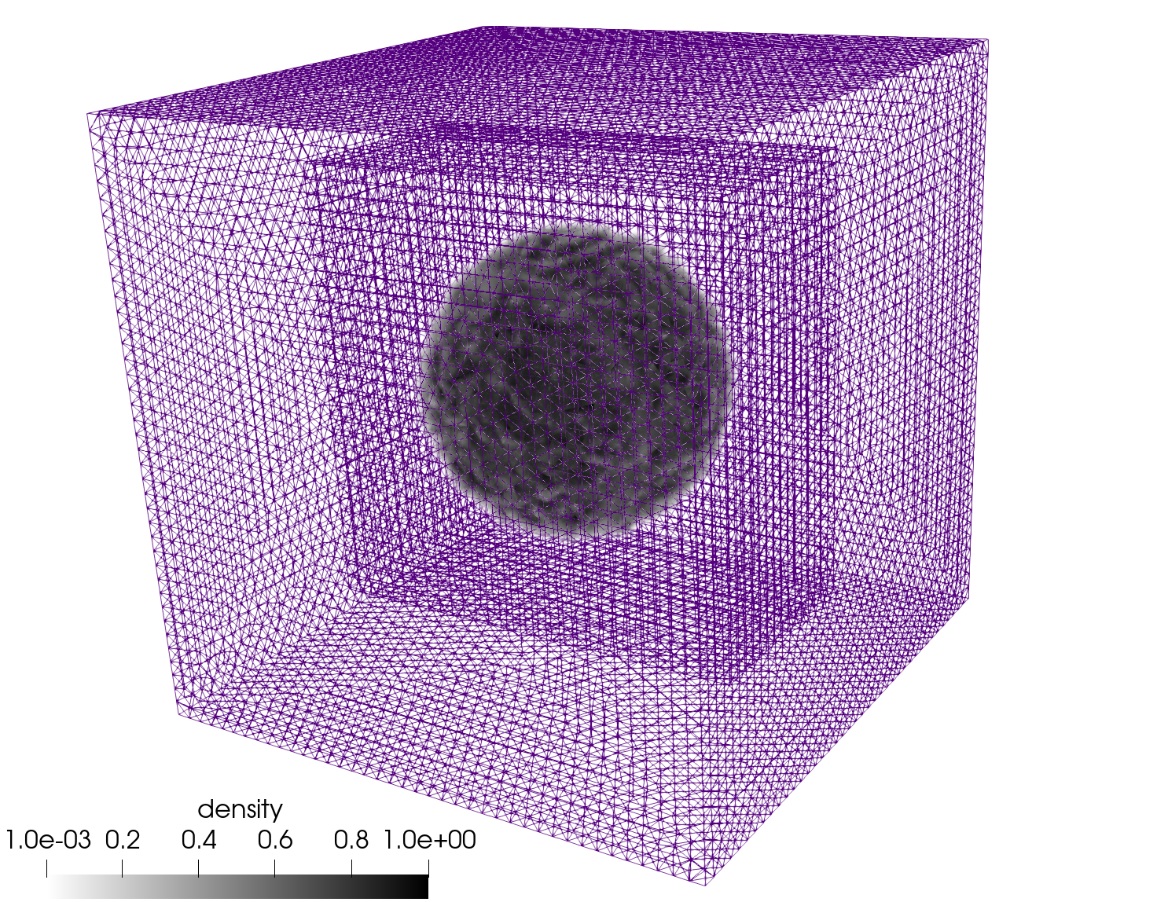
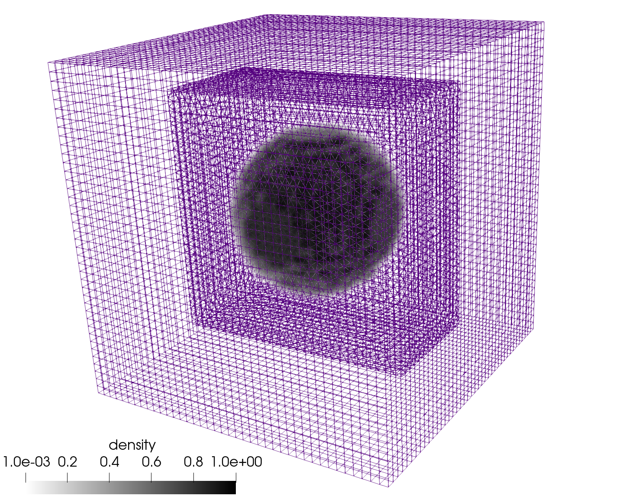
Objective: Overset + Volume of Fluid (VOF)
Molenkamp verification case, now with overset
Static bubble (computed curvature)
Hex8, Tet4, and Hex8/Tet4 Balanced Force
static bubble; density ratio = 1000

Slide 20
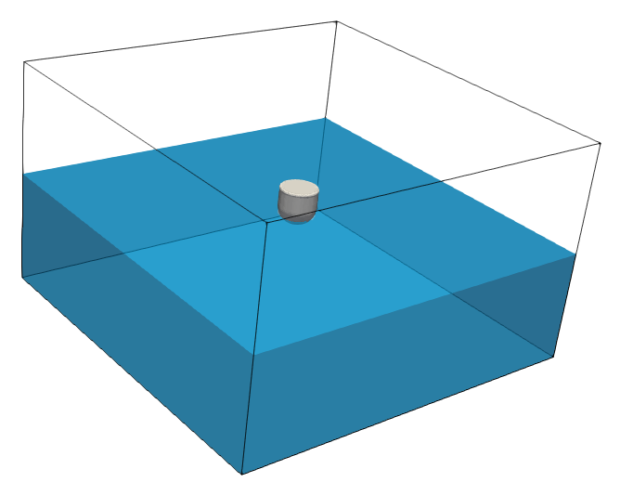

Validation: Unmoored Buoy Drop (Quiescent Conditions)
Comparisons are made to experimental data from the UK Centre for Marine Energy Research (UKCMER) of the WEC vertical displacement given in Ransley et al., Renew. Ener. (2017) who exercised a mesh deformation construct
5 m
5 m
0.5 m
3 m
0.25 m
0.25 m

Slide 21
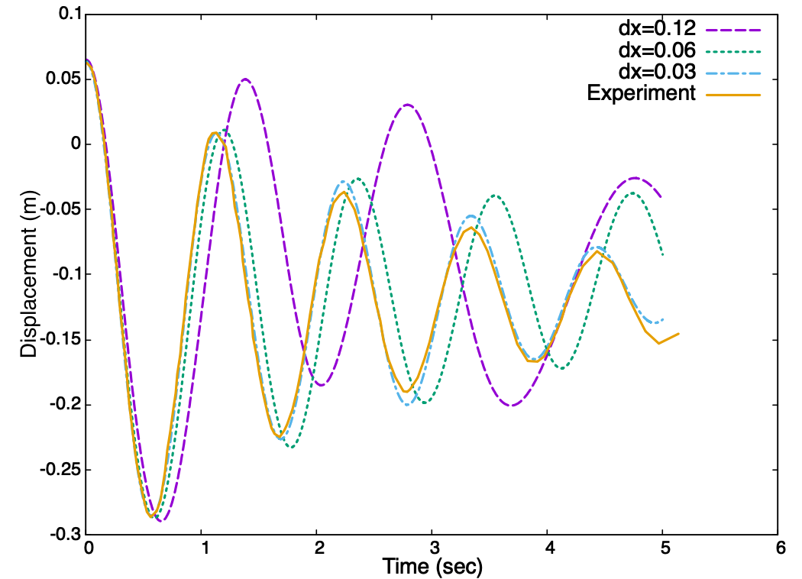
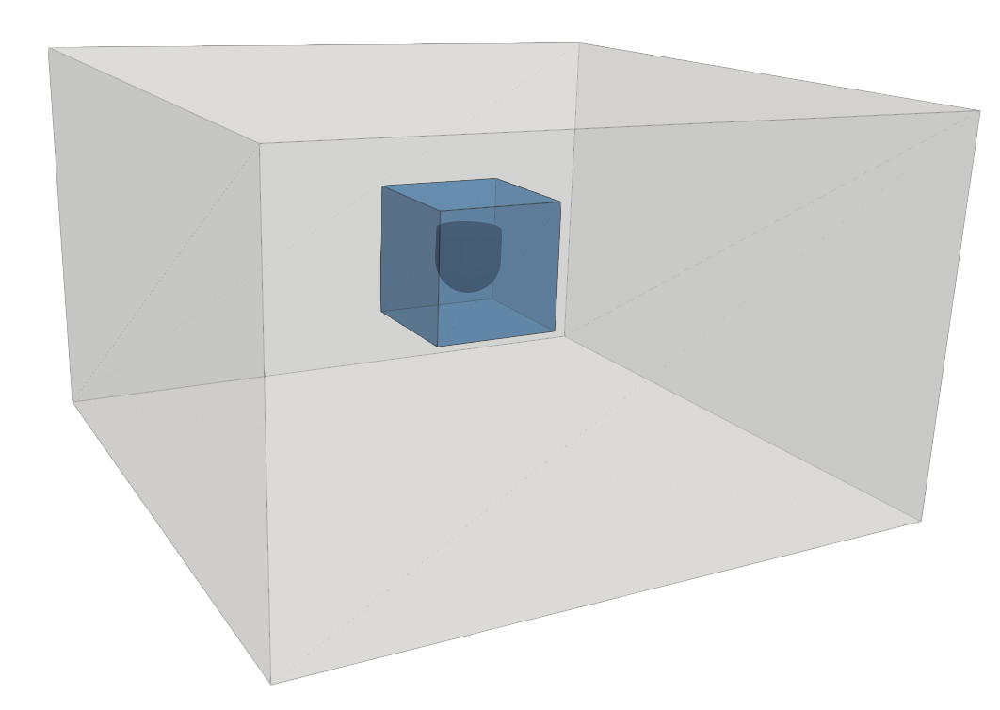
Validation: Unmoored Buoy Drop (Quiescent Conditions)
Objective: Compare to experimental dataset and demonstrate grid convergence
Displaced buoy vertically; QoI: center of mass spatial location as a function of time
Finding: Improved comparison over other works found in literature, e.g., WEC vertical displacement given in Ransley et al., Renew. Ener. (2017)
0.31 m

Slide 22
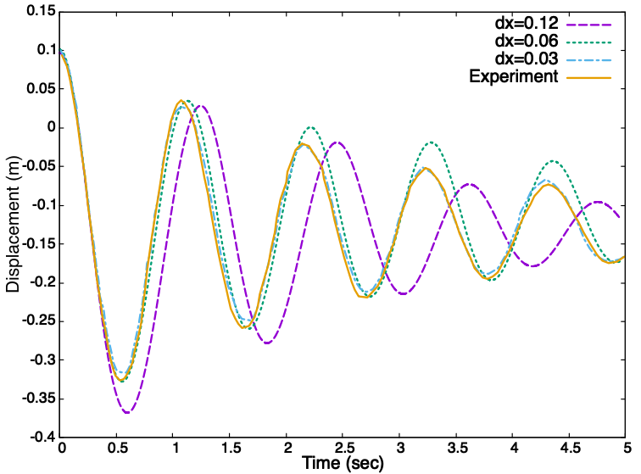
Validation: Moored Buoy Drop (Quiescent Conditions)
Objective: Compare to experimental dataset and demonstrate grid convergence – now tethered
Displaced buoy vertically; QoI: center of mass spatial location as a function of time
Similar Finding: Improved comparison over other works found in literature, e.g., WEC vertical displacement given in Ransley et al., Renew. Ener. (2017)
0.31 m
k = 500 N/m spring force

Slide 23
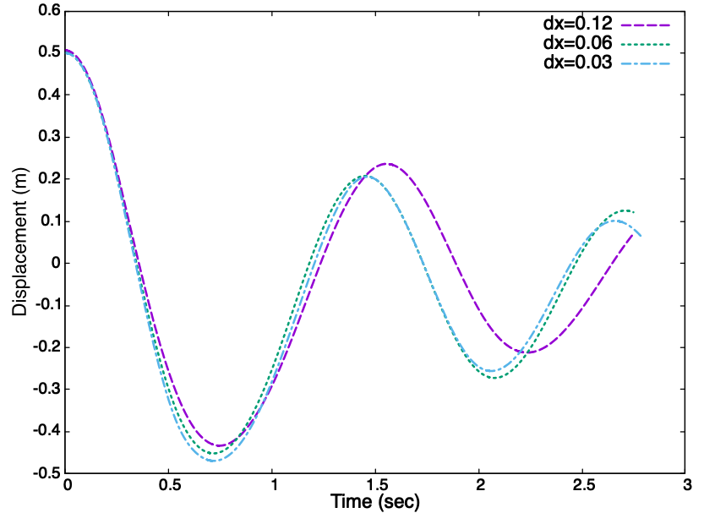
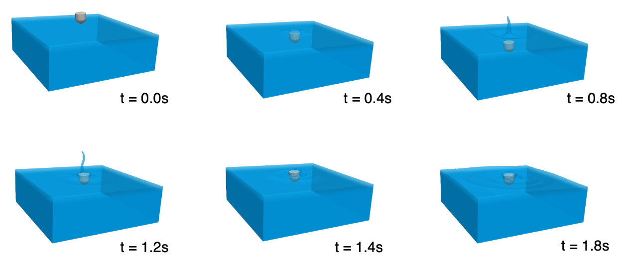
Buoy Dropped Into Quiescent Pool; large displacement limit Validation Benchmark, Domino and Horne, Renew. Energy (2022)
Large-displacement sample case run that can serve as a numerical benchmark

Slide 24
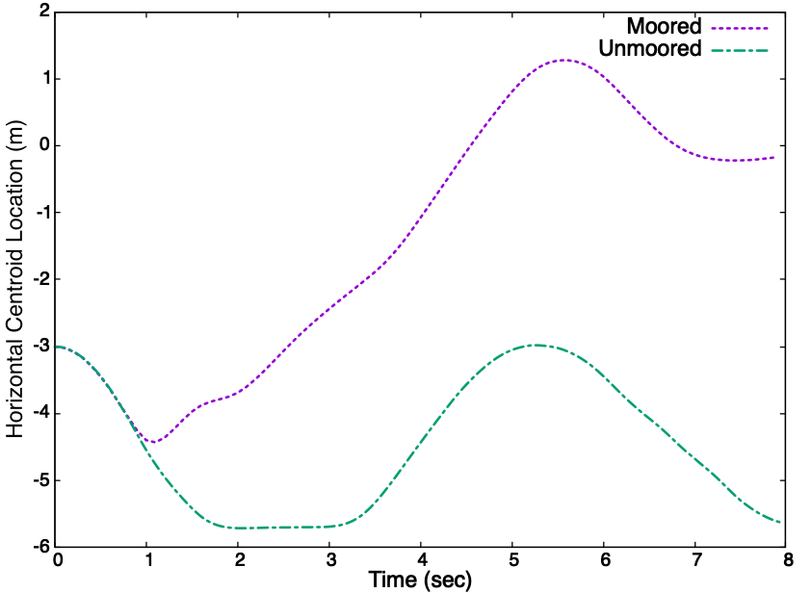
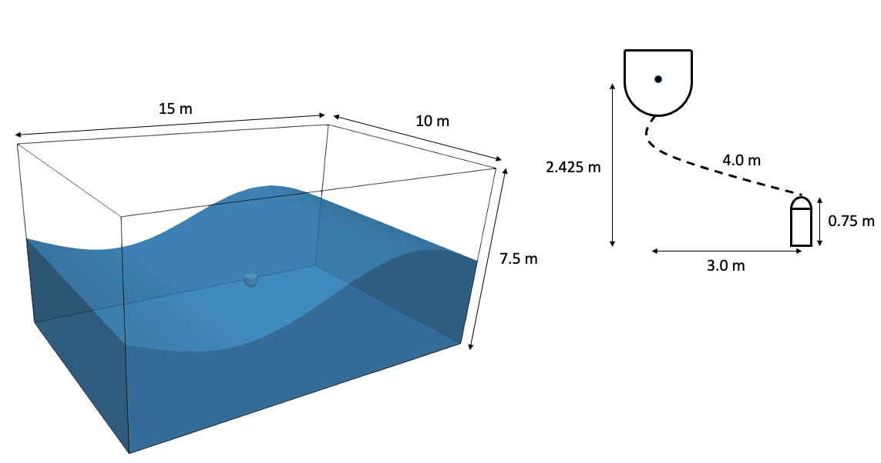
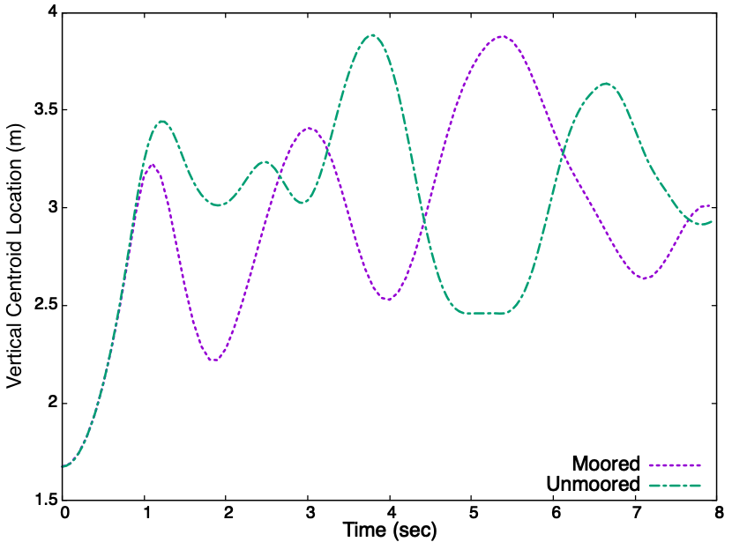
Buoy Subjected to large Wave-Form Validation Benchmark, Domino and Horne, Renew. Energy (2022)
Large-displacement sample case run that can serve as a numerical benchmark for the community; with and without mooring
Geometric center = f(t) relative to the tether’s mounting point

Slide 25
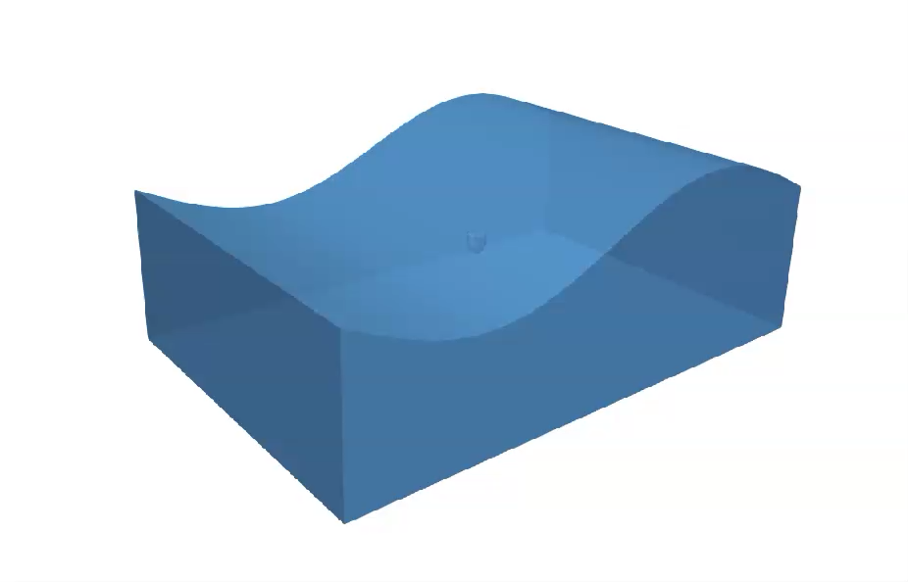
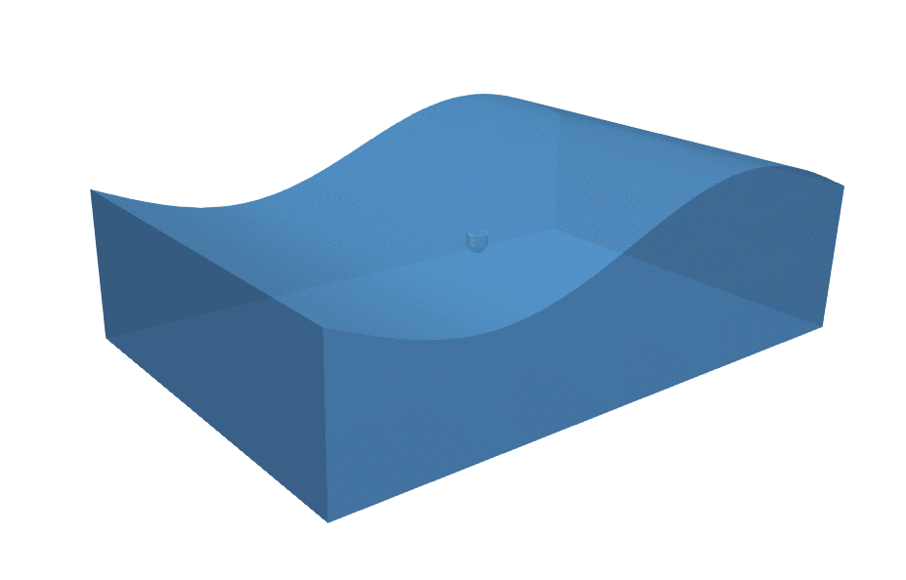
Buoy Subjected to large Wave-Form Validation Benchmark: Without (left) and With (right) Mooring

